Slide 1

Is your organization ready for impact?
David Phipps, Executive Director
Research & Innovation Services, York University
Network Director, Research Impact Canada
@researchimpact

Slide 2
“community”
“community”
Impact Planning
(= KT strategy)
Impact Assessment (= evaluation)
Knowledge Translation
Impact
HOW
campus
WHAT
campus
Knowledge translation strategy
Pathway to impact
Impact strategy
Outcomes statement
Impact assessment
Evaluation
Knowledge translation helps make evidence useful to society
@researchimpact

Slide 3

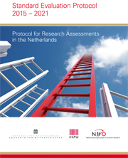
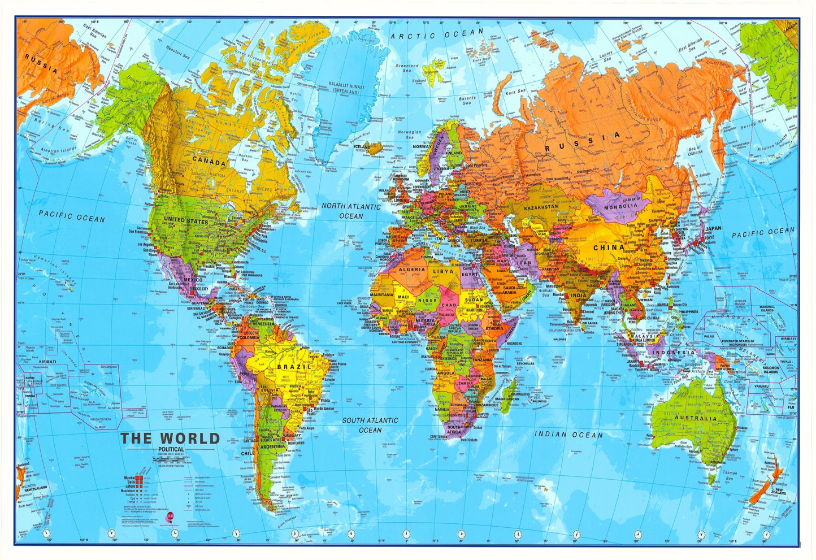





some examples of impact systems
MISSION DRIVEN
= HOW
ASSESSMENT DRIVEN
= WHAT

Slide 4
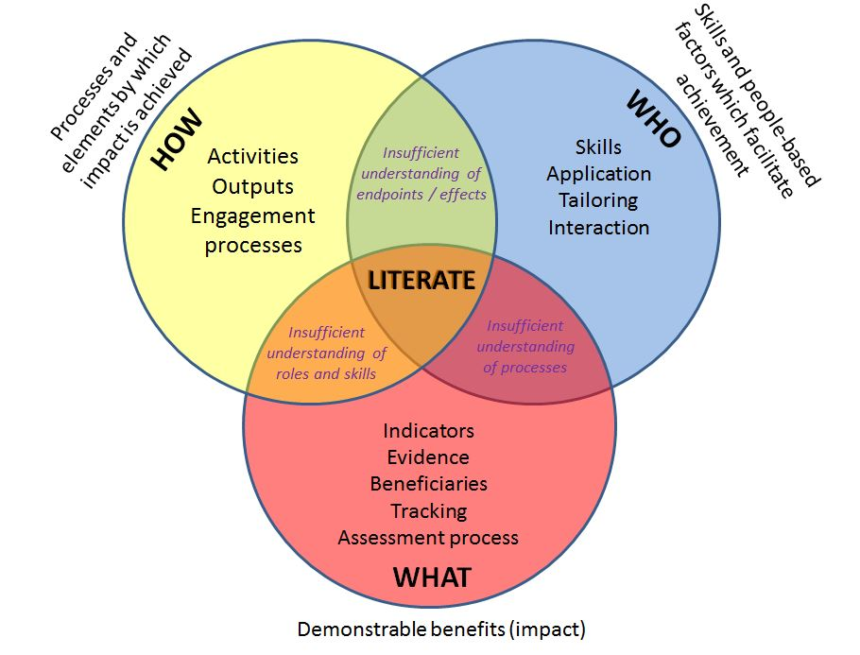
Research
Impact Literacy
Bayley, J.E. and Phipps, D. (2017) Building the concept of research impact literacy. Published on line in Evidence & Policy http://www.ingentaconnect.com/content/tpp/ep

Slide 5

Public policies
Funding: research, operations
Institutional policy/plans
Services
Infrastructure
Funding
Collaboration
Students
Dissemination
End user perspective
RESEARCHER ↔ PARTNER
@researchimpact

Slide 6
Public policies
Funding: research, operations
Institutional policy/plans
Services
Infrastructure
Funding
Collaboration
Students
Dissemination
End user perspective
RESEARCHER ↔ PARTNER
@researchimpact

Slide 7
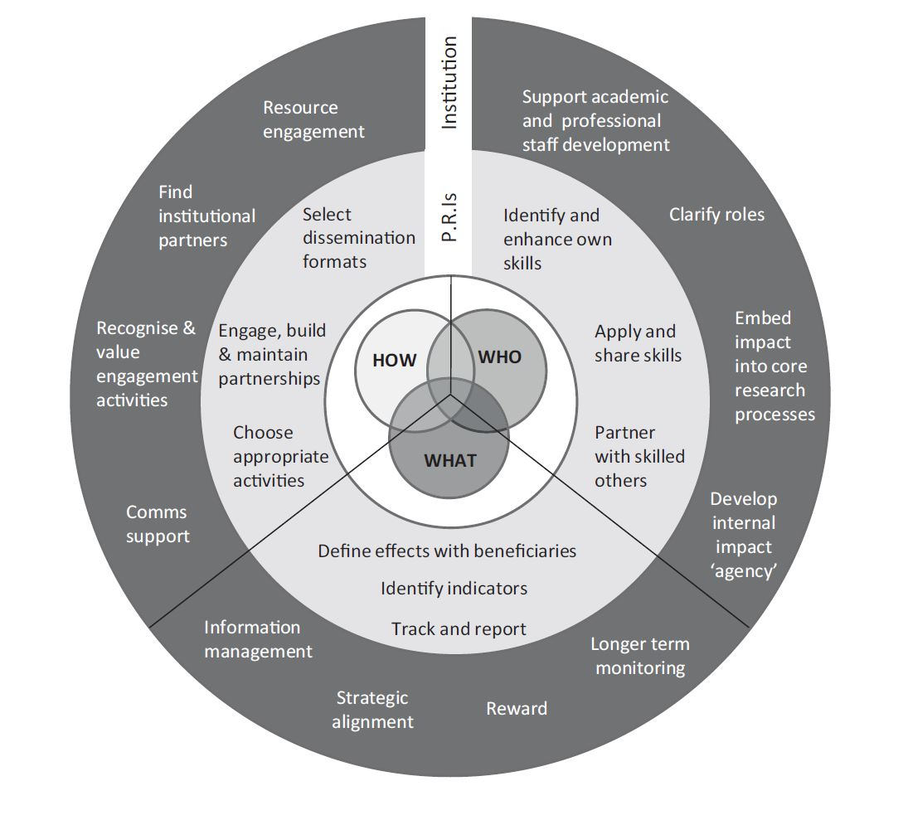
InstitutionalResearch
Impact Literacy
Bayley, J.E. and Phipps, D. (2017) Building the concept of research impact literacy. Published on line in Evidence & Policy http://www.ingentaconnect.com/content/tpp/ep

Slide 8
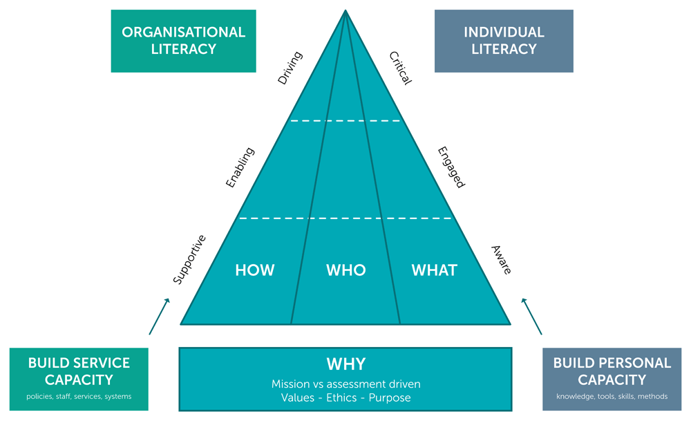
Research
Impact Literacy
Bayley J and Phipps D. Extending the concept of research impact literacy: levels of literacy, institutional role and ethical considerations [version 1]. Emerald Open Res 2019, 1:14 (doi: 10.12688/emeraldopenres.13140.1)

Slide 9
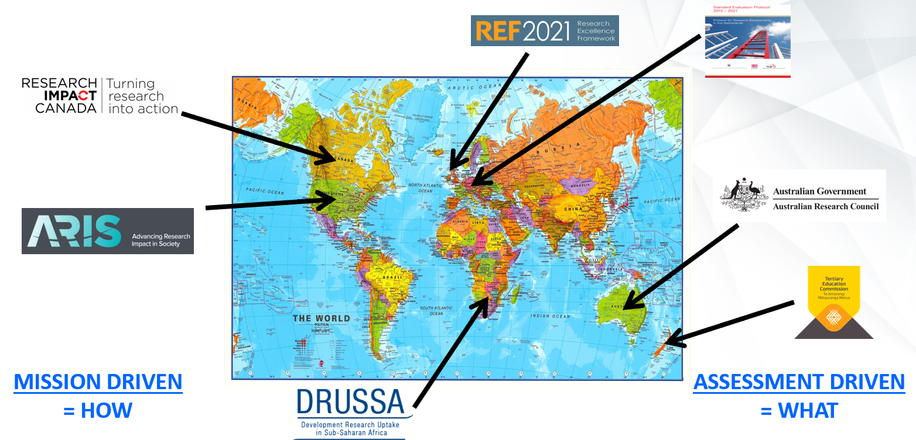
WHY
Purpose: advocacy, analysis, accountability and allocation
Ethics: power, mutual respect, OCAP,
Unintended consequences: grimpacts, himpacts
Mission or Assessment driven

Slide 10
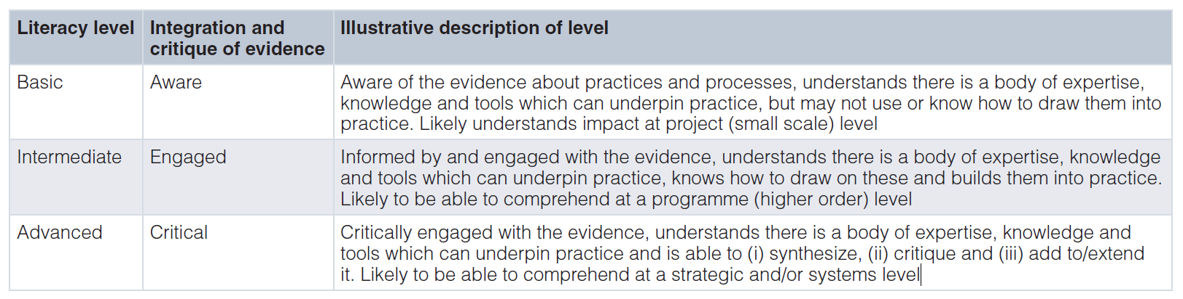
Individual Impact Literacy
@researchimpact

Slide 11
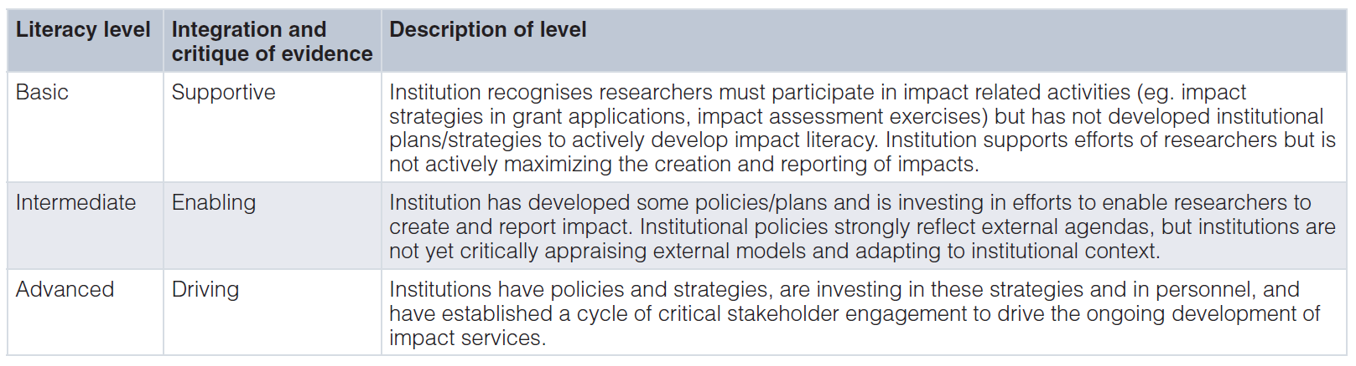
Organizational Impact Literacy
@researchimpact

Slide 12
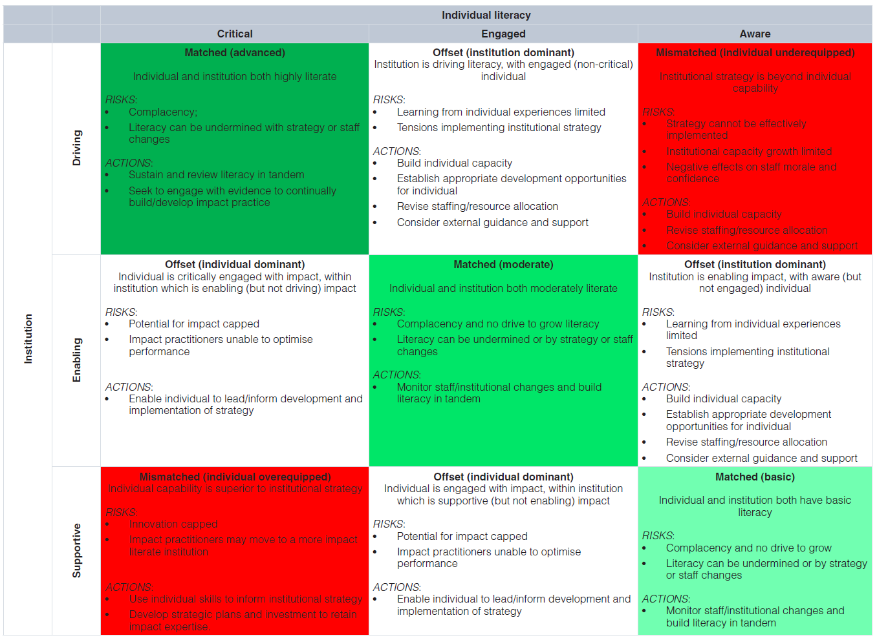
@researchimpact

Slide 13
Public policies
Funding: research, operations
Institutional policy/plans
Services
Infrastructure
Funding
Collaboration
Students
Dissemination
End user perspective
RESEARCHER ↔ PARTNER
@researchimpact

Slide 14

An institutional priority: York U
Knowledge for the Future: From Creation to Application
expanding the influence of our work through broadening and deepening our external partnerships and engagement in the generation and sharing of knowledge and creative works
maximizing our impact by building on the success of Innovation York to expand student, faculty, and community access to entrepreneurial programming and to increase our innovation activities
Working in Partnership
developing with partners in Vaughan an integrated, interdisciplinary health precinct that will serve the needs of a growing region, while creating synergies for health-related research, teaching, and innovation
establishing a UN-sponsored CIFAL1 centre to provide cross-sectoral training and development programs that will advance the UN SDGs
connecting our entrepreneurship and innovation activities to the broader innovation ecosystem of Ontario
Living Well Together
continue our actions to support reconciliation through our Indigenous Framework, including additional Indigenous spaces and art works
2020-2025
@researchimpact

Slide 15



Entrepreneurship, start up companies: hot desks, shared meeting rooms
School/community outreach
Maker space
Community engagement
Community based research
Legal aid, practicum placements, experiential education
Knowledge mobilization, research partnerships
Grant support
Graduate student research/engagement
@researchimpact

Slide 16
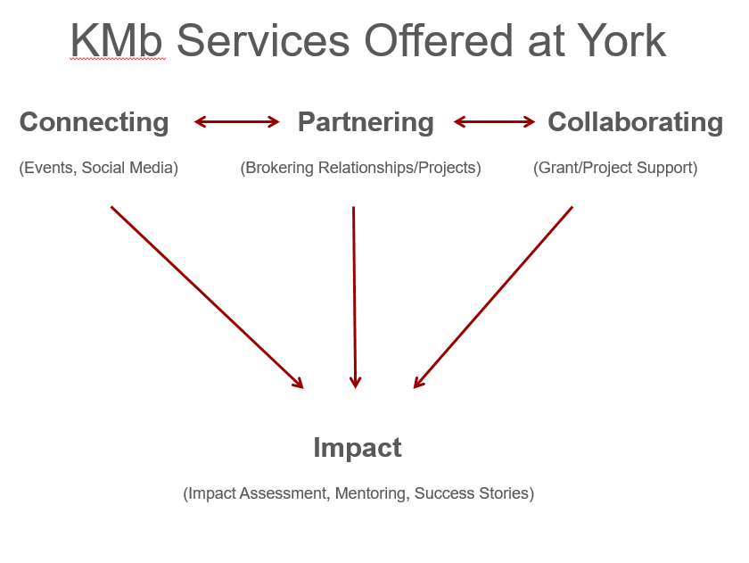
2 full time staff
2 student assistants
$300K/year
@researchimpact

Slide 17
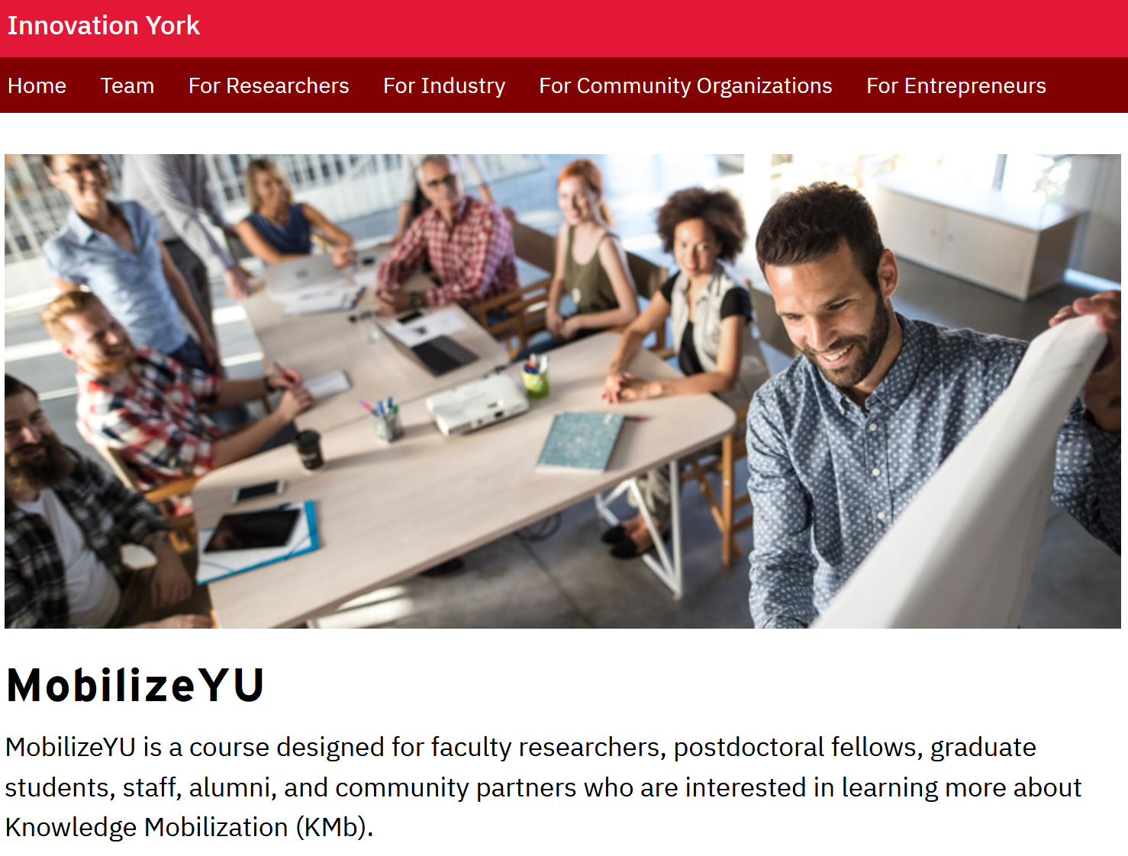

Slide 18
 | 2018-2019 | 2019-2020
New Brokering Projects | 30 | 34
Faculty Engaged | 166 | 154
Partners Engaged | 134 | 468
Students Engaged | 259 | 284
Funding Applications Submitted | 30 | 26
Value of Applications* | $34,800,000 | $9,100,000
Events Attended | 27 | 22
Events Supported or Led | 35 | 43
*Total external research income from
KMb Unit supported applications (2006-2019) =$99M
@researchimpact

Slide 19
Research
Impact Literacy
Bayley J and Phipps D. Extending the concept of research impact literacy: levels of literacy, institutional role and ethical considerations [version 1]. Emerald Open Res 2019, 1:14 (doi: 10.12688/emeraldopenres.13140.1)

Slide 20
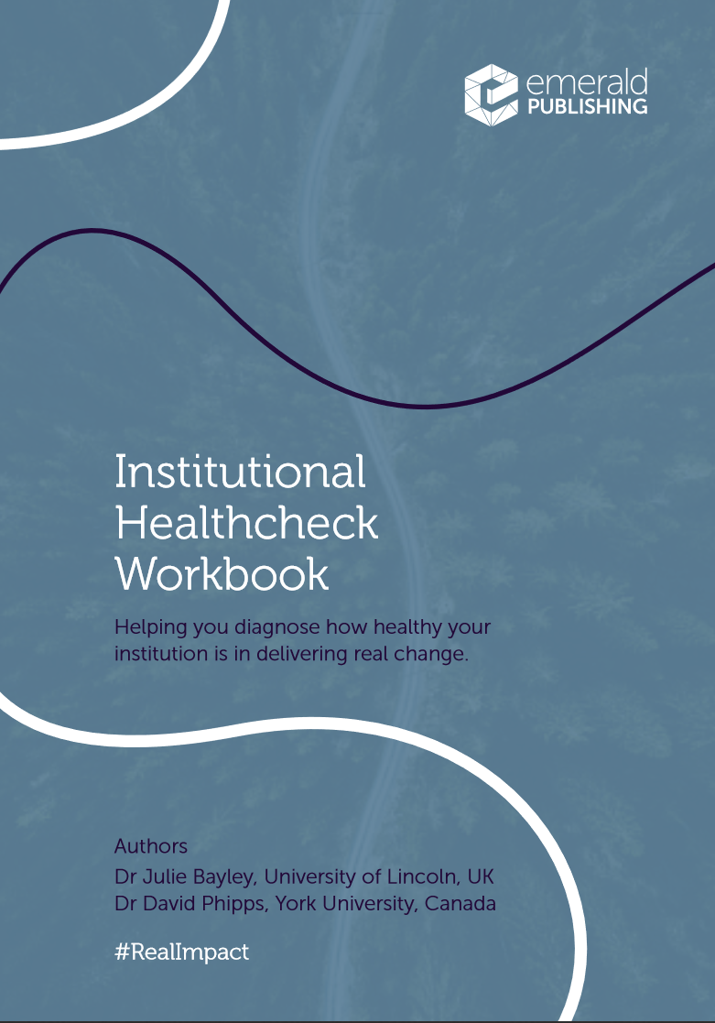
Commitment
  Is the organization committed to impact: strategy, systems, staff?
Connectivity
  Do the organizational units work together, connect to strategy, cohesive?
Clarity
  Do (non)academic staff understand impact, expectations, roles?
Competencies
  Is there advice, training, support to develop skills for impact?
Co-production
  What is the extent and quality of engagement with non-academic stakeholders?
https://www.emeraldgrouppublishing.com/sites/default/files/2020-06/Institutional%20Healthcheck%20Workbook%20Final.pdf

Slide 21
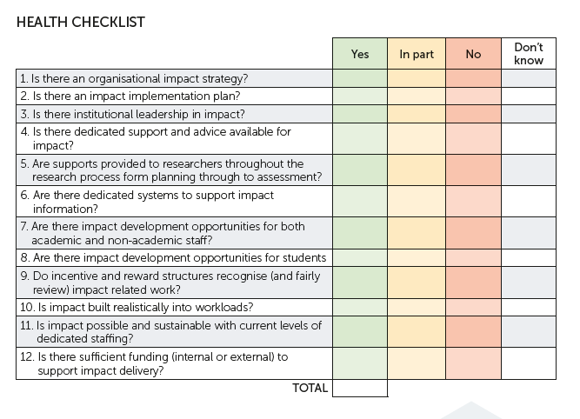
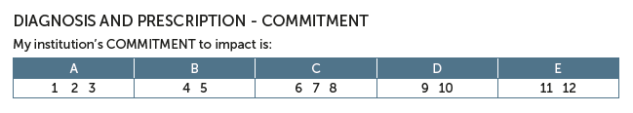
COMMITTMENT
Is the organization committed to impact: strategy, systems, staff?
@researchimpact

Slide 22
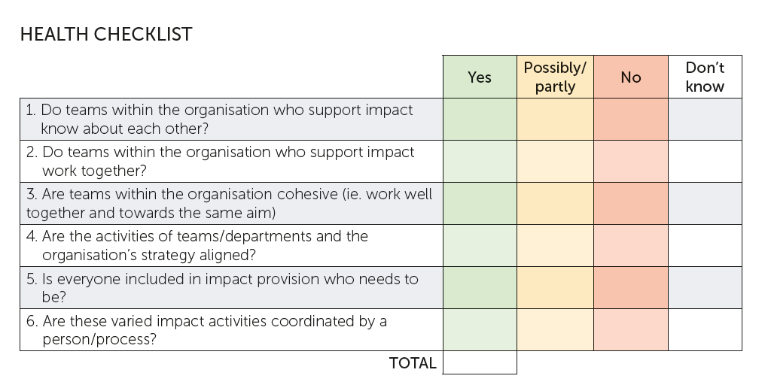
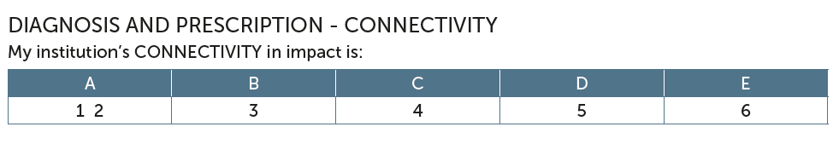
CONNECTIVITY
Do the organizational units work together, connect to strategy, cohesive?
@researchimpact

Slide 23
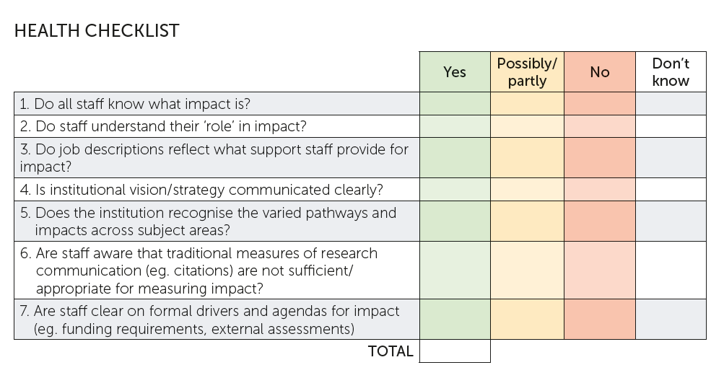
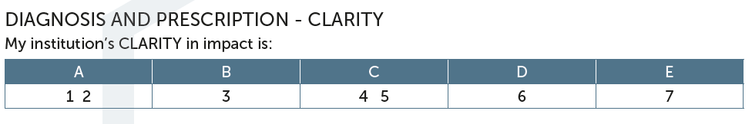
CLARITY
Do (non)academic staff understand impact, expectations, roles?
@researchimpact

Slide 24
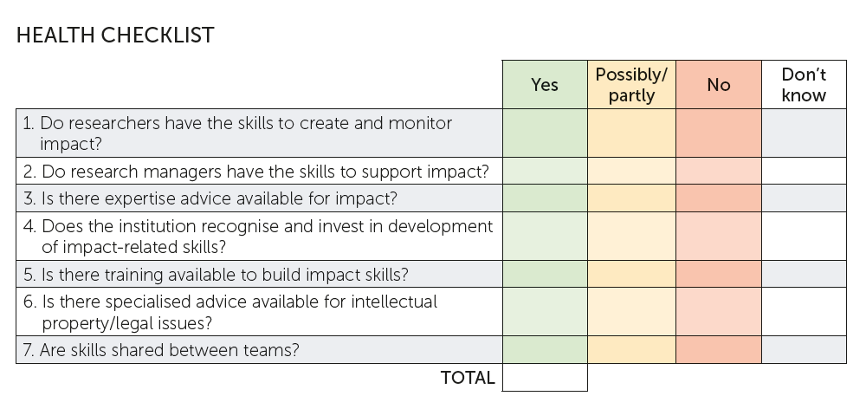
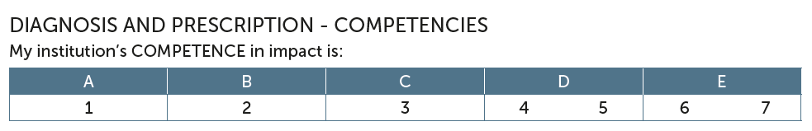
COMPETENCIES
Is there advice, training, support to develop skills for impact?
@researchimpact

Slide 25
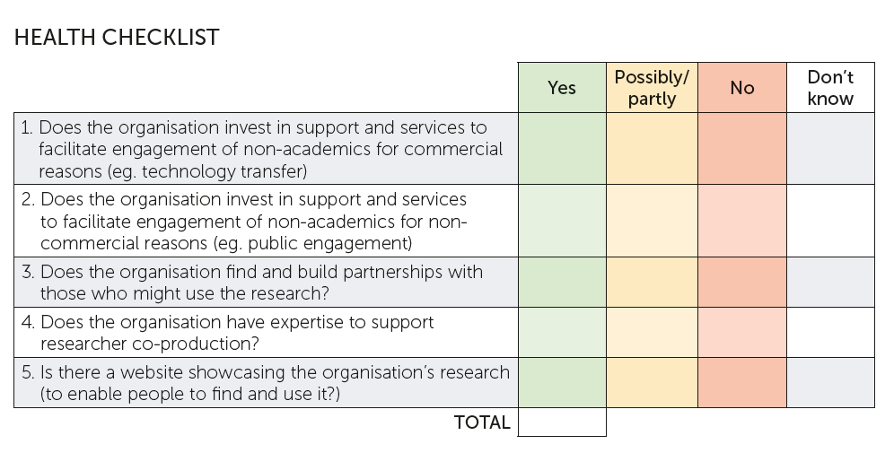
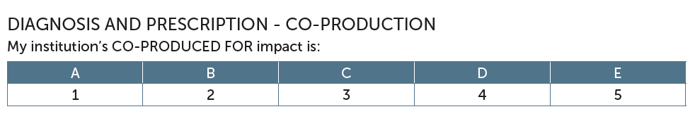
CO-PRODUCTION
What is the extent and quality of engagement with non-academic stakeholders?
@researchimpact

Slide 26
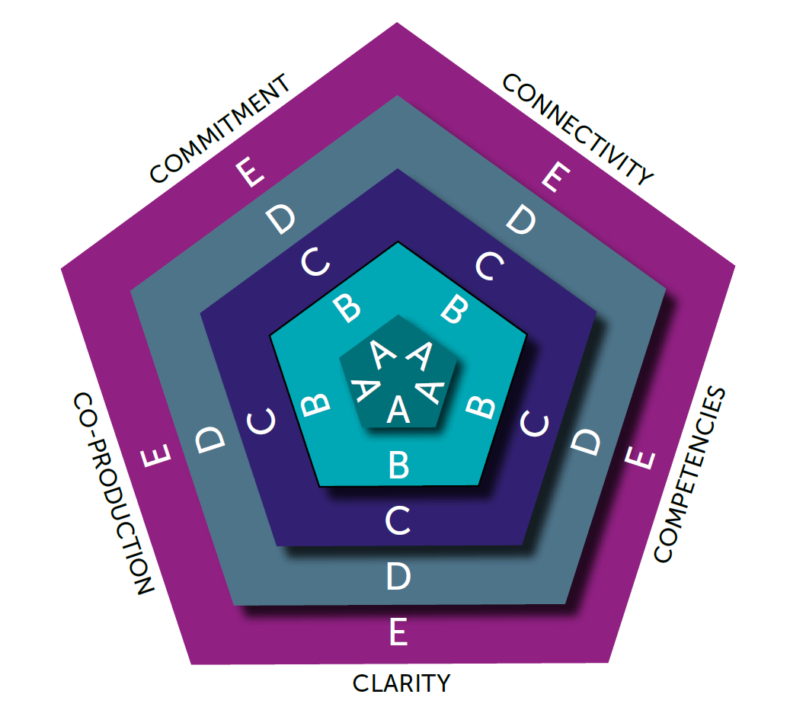
A. Prescription
B. Monitor at 6, 12, 24 months
What has worked?
What has been a challenge?
Next steps?
@researchimpact

Slide 27

@researchimpact

Slide 28


Slide 29

1530-1550: Breakout groups
One element/table
Choose an organization
Complete Assessment – assign a score
What are your challenges?
What is your prescription?
What do you need to accomplish this?
1550-1630
Report back to large group
@researchimpact

Slide 30


Slide 31
@researchimpact

